Slide 1

ONLINE RESUME BUILDER
A resume builder is an online tool that you can use to quickly create a resume.
Submitted To : -
Bhoopati Subramani Sir
(Assistant Professor)
28940
Submitted By: -
Ekhlakh Ahmad. Reg No.: - 12209166.
Sukhdeep Kaur. Reg No.: - 12209123.

Slide 2



iNTRODUCTION
A Resume builder is a software developed to simplify the task of creating a resume for individuals. The application provides an effective means of designing desired resume in fact a professional looking resume. This project is user-friendly and requires minimum human intervention. Individuals just must fill up a form that specifies questions from all required fields such as personal questions, educational, qualities, interest, skills and so on. The answers provided by the users are stored and the system automatically generates a well-structured resume. Users have option to create resume in any format and file.

Slide 3
MODULES OF RESUME BUILDER
Login and Register page
HOME PAGE
BUILD NEW CV’S
CONTACT US
ACCOUNT SETTING

Slide 4
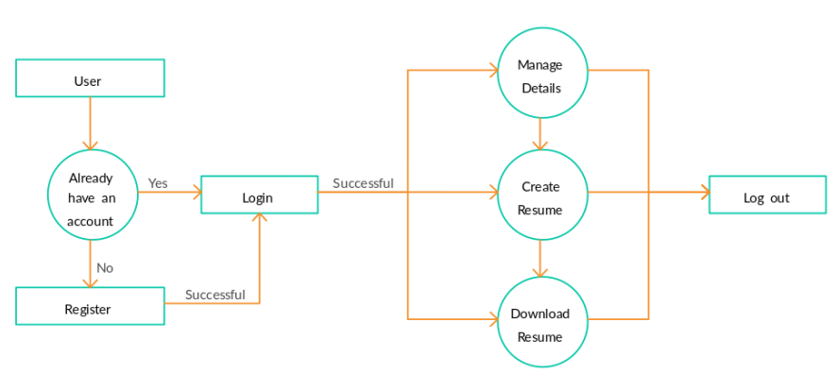
Use case

Slide 5
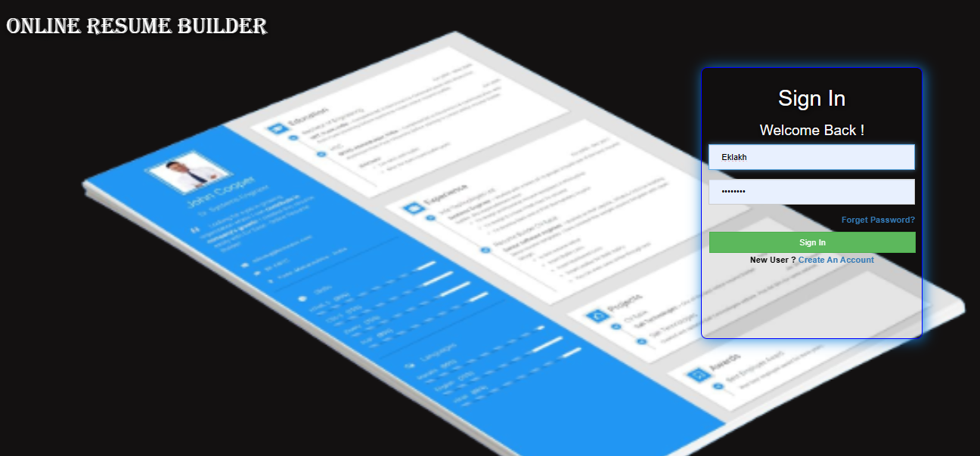
LOGIN PAGE

Slide 6
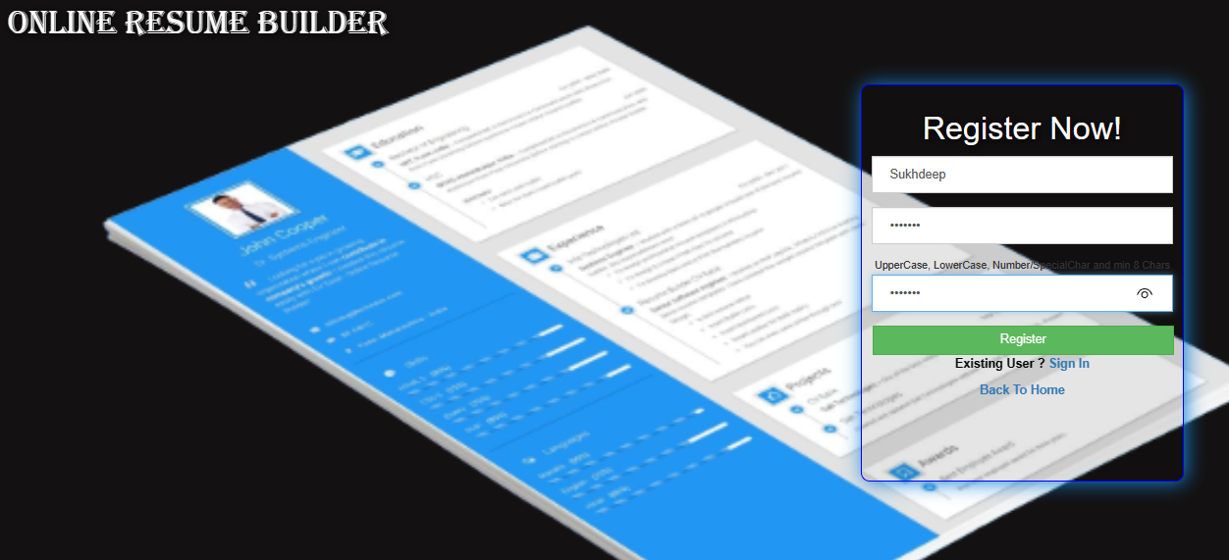
REGISTER PAGE

Slide 7
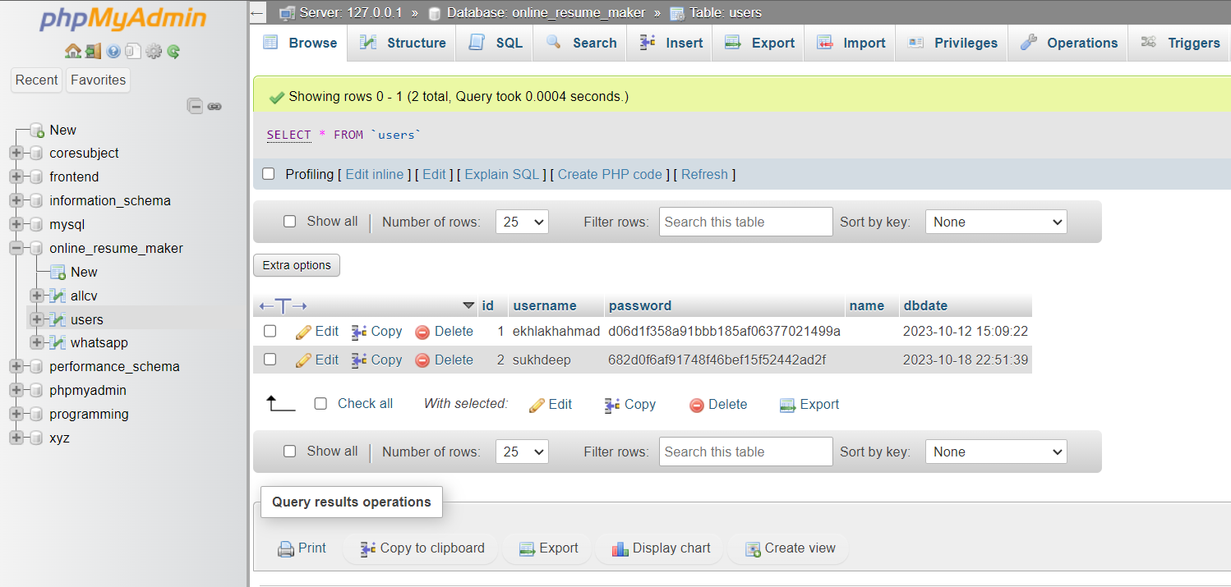
database

Slide 8
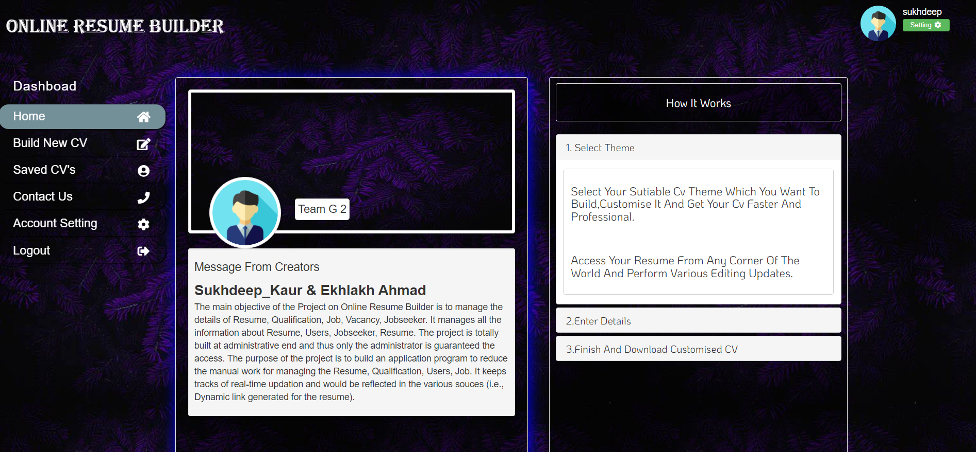
Home page

Slide 9
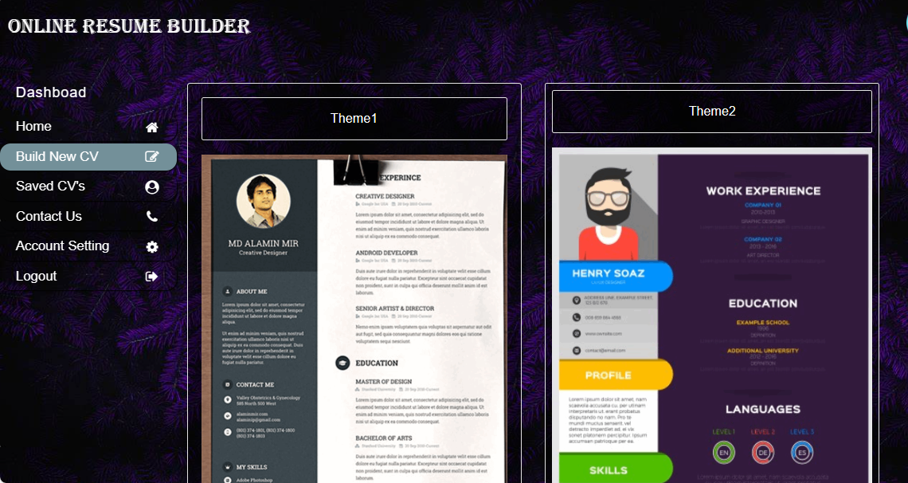
Themes

Slide 10
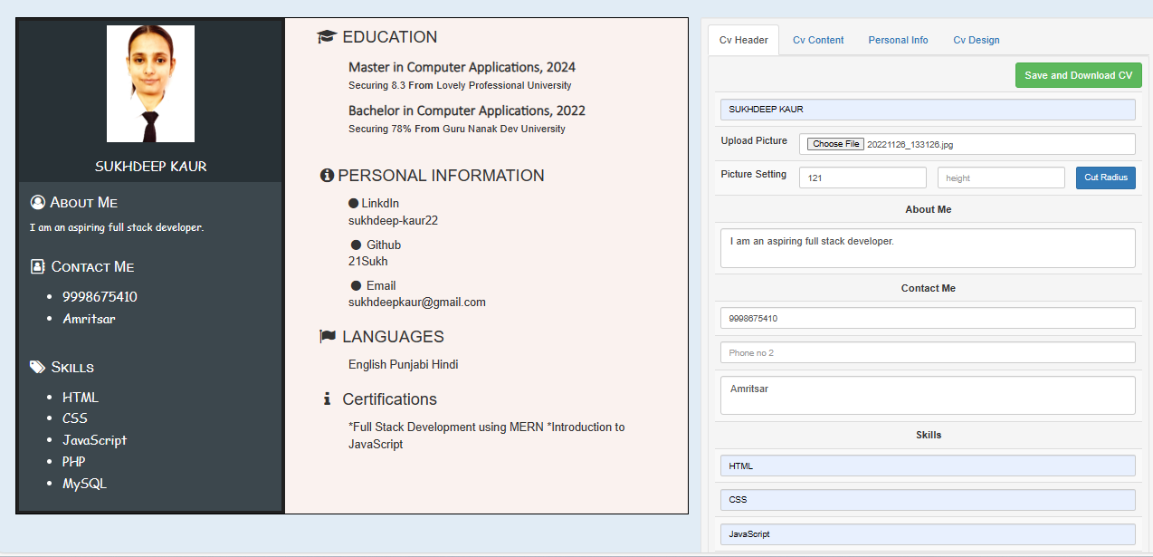
CV Creation

Slide 11
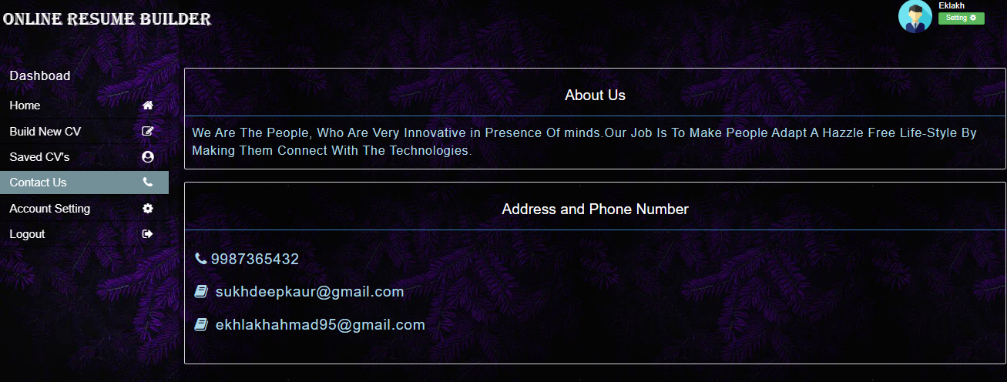
Contact Us

Slide 12
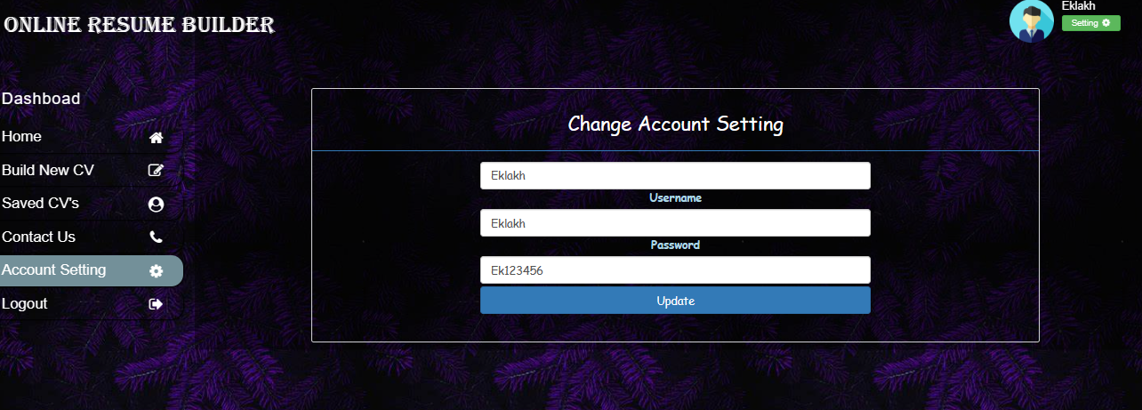
Account Setting
Here you can change the username and password.

Slide 13
Future Improvement
Add more themes
Themes according to the professions

Slide 14
Thank You

